Slide 1
CSE 2500: Introduction to Discrete Systems
Lecture 14: More Proofs by Contradiction and Contraposition
Kaleel Mahmood
Department of Computer Science and Engineering
University of Connecticut

Slide 2
Review from last lecture
Relationship between proof by contradiction and proof by contraposition
Sequences

Slide 3
Review from last lecture

Slide 4
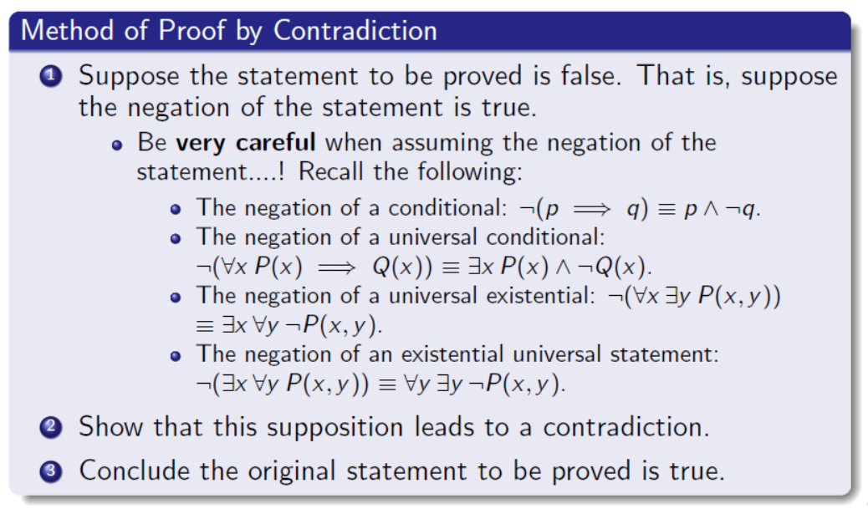
Proof by Contradiction

Slide 5
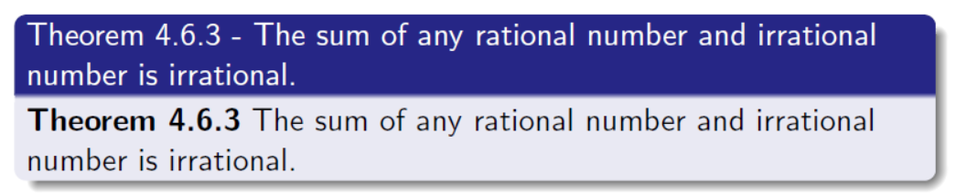
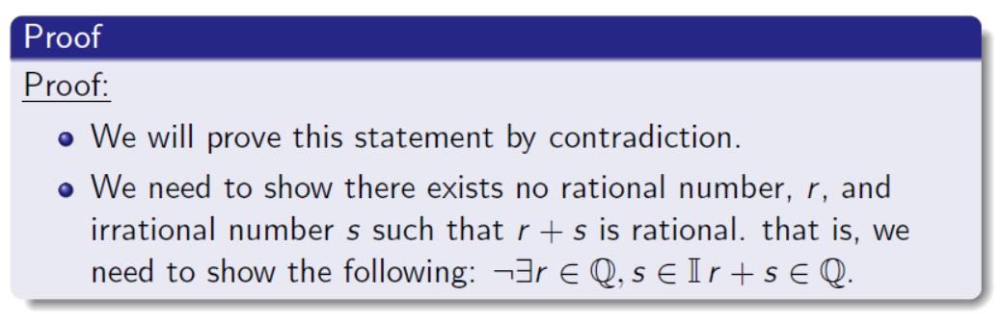
Example that we did last time on the white board

Slide 6
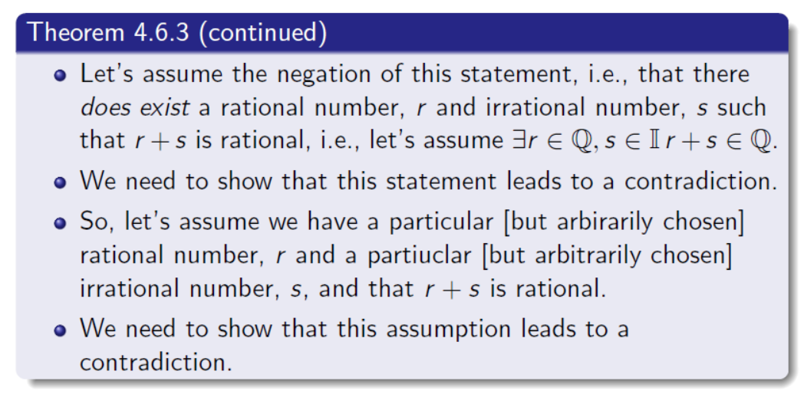
Example that we did last time on the white board

Slide 7
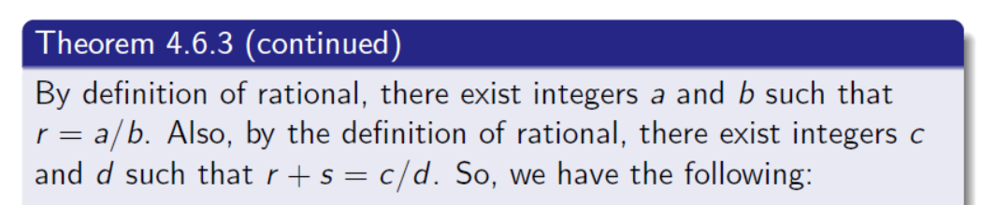

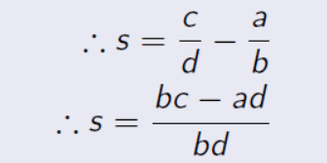

Slide 8
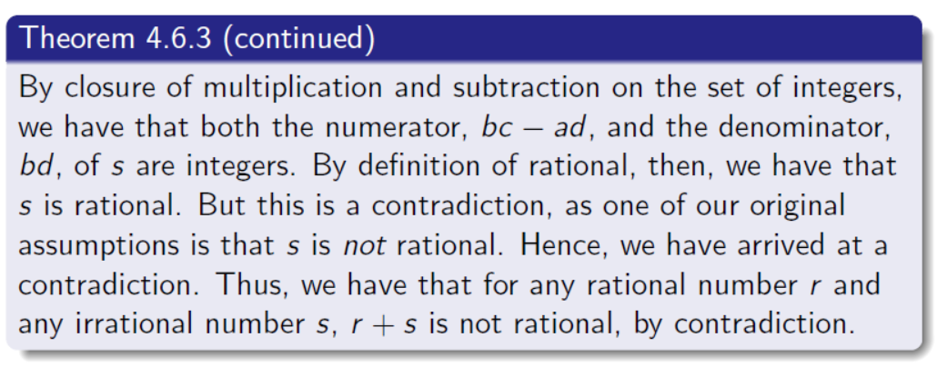

Slide 9
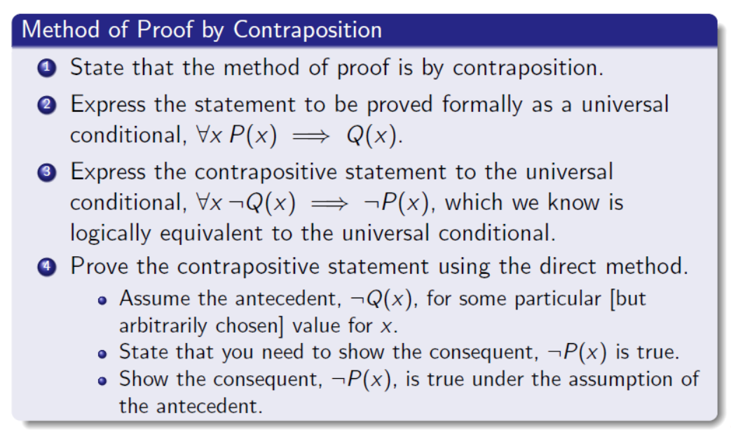
Indirect Argument - Contraposition

Slide 10
Relationship between proof by contradiction and proof by contraposition (new stuff)

Slide 11
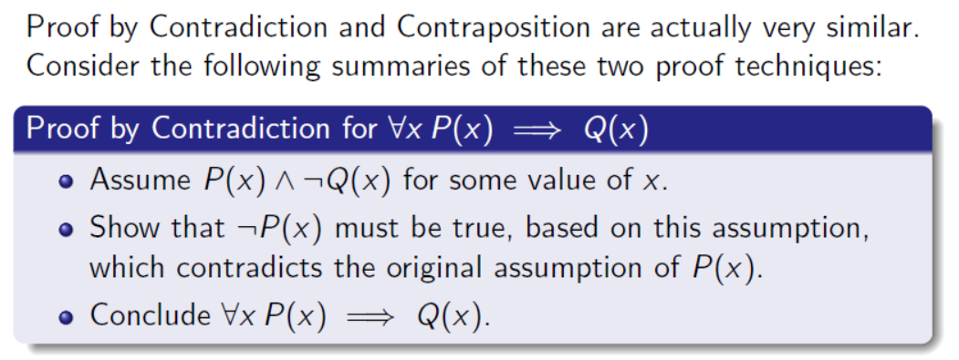
What are the steps in contradiction?

Slide 12
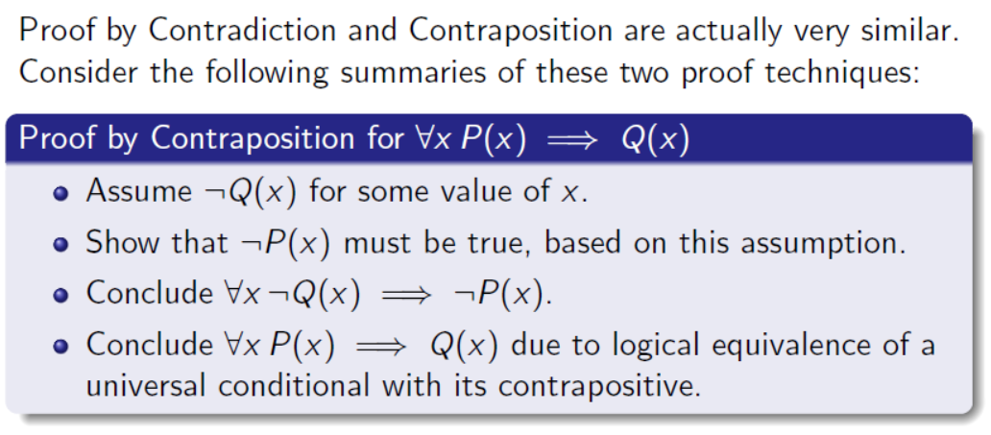
What are the steps in contraposition?

Slide 13
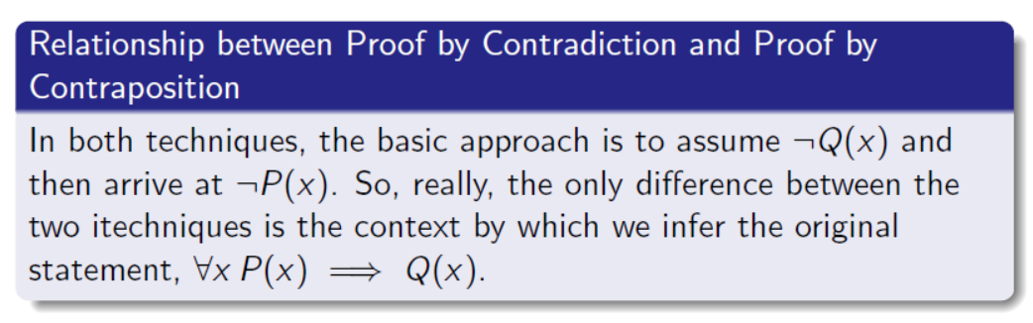
Relationship between the two:
Let’s do one example where we can prove a statement using BOTH approaches

Slide 14
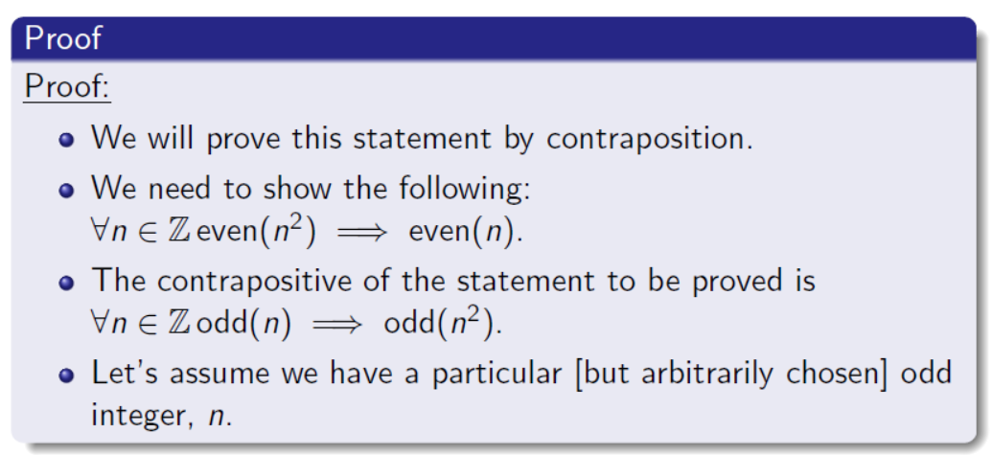
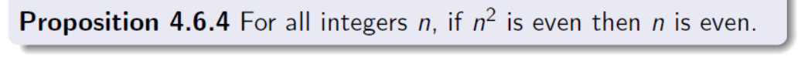
First Proof: Through Contraposition (we did this last lecture)

Slide 15
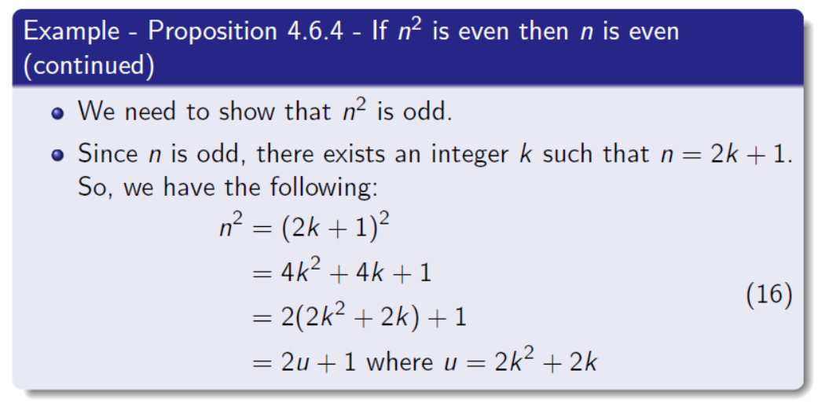
Proof by Contraposition Example (part 2)

Slide 16
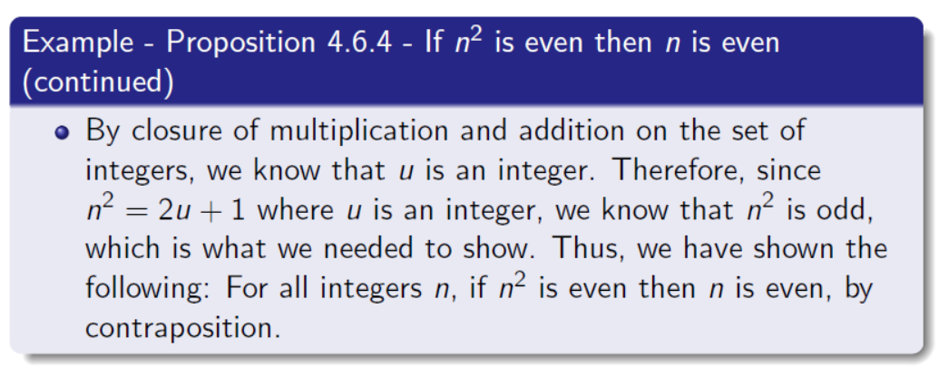

Slide 17
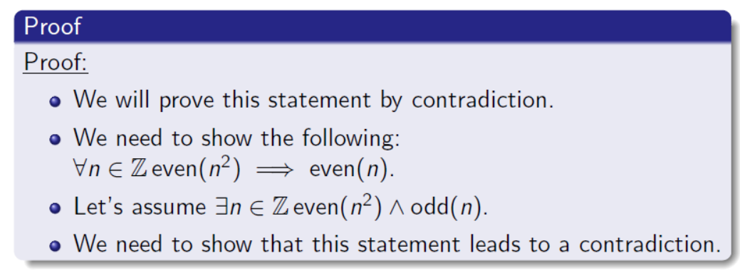
Second Proof: Through Contradiction

Slide 18
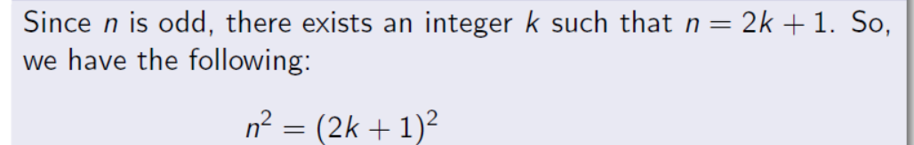

Second Proof: Through Contradiction

Slide 19
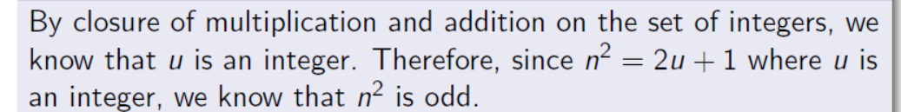
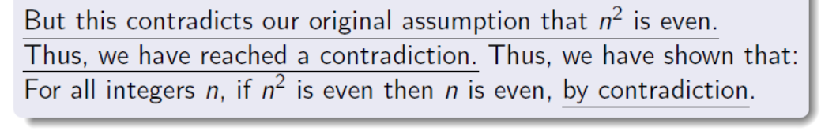
Second Proof: Through Contradiction

Slide 20
White Board Example

Slide 21
Sequences

Slide 22
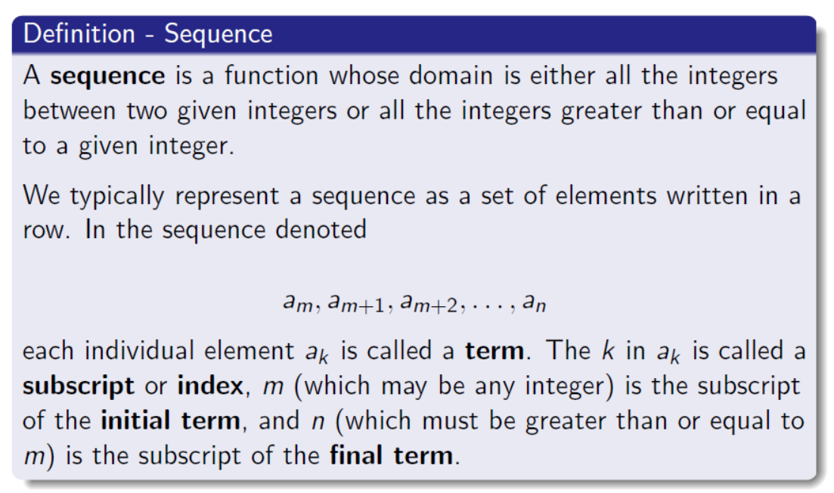

Slide 23
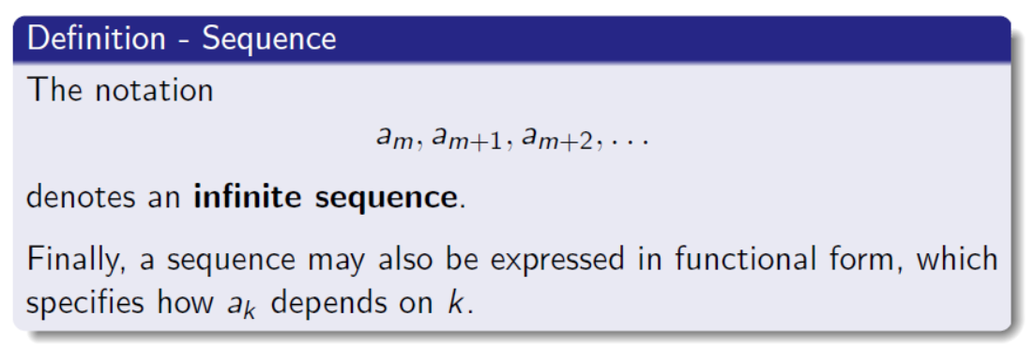
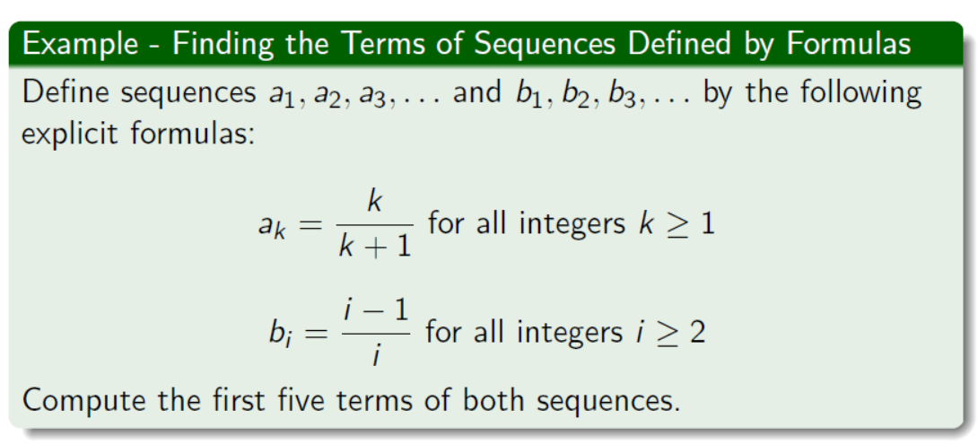

Slide 24
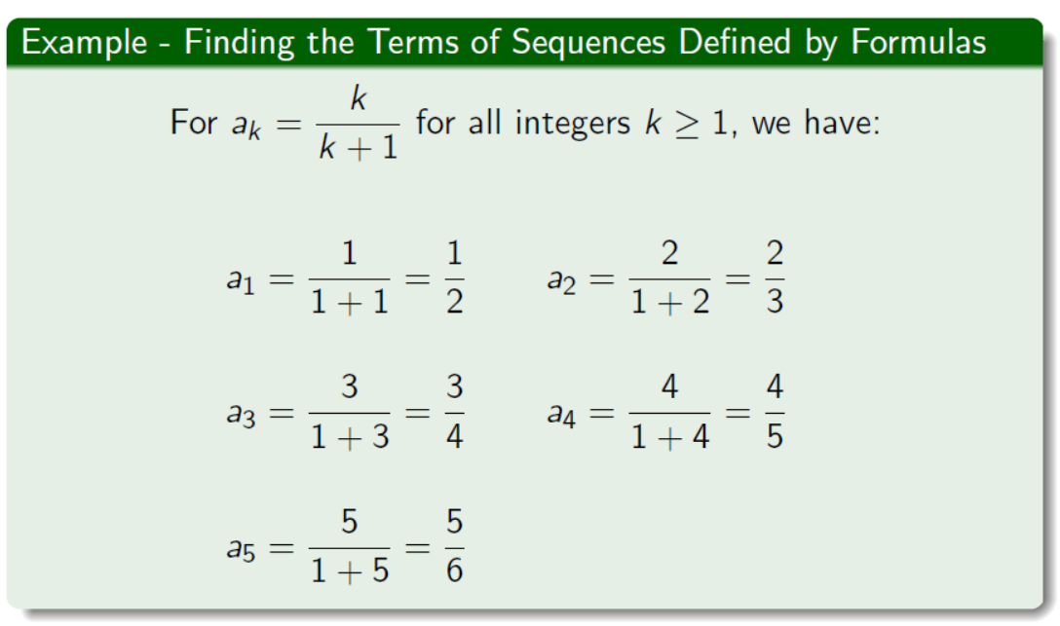

Slide 25
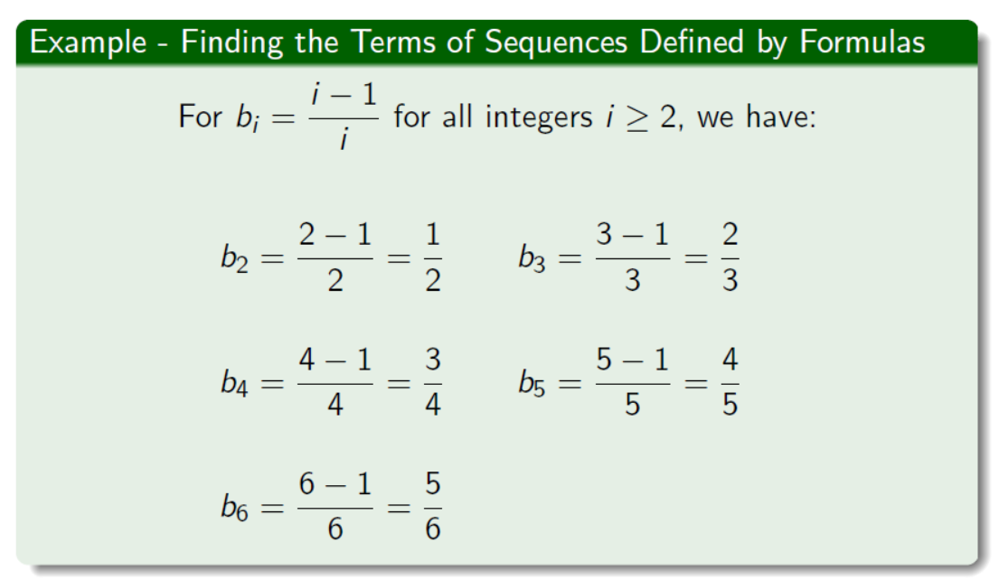
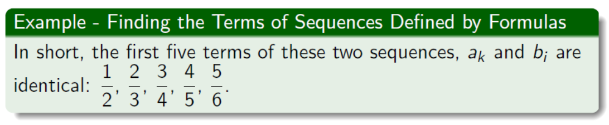

Slide 26
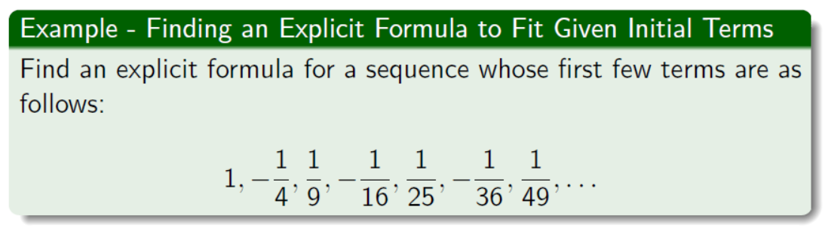
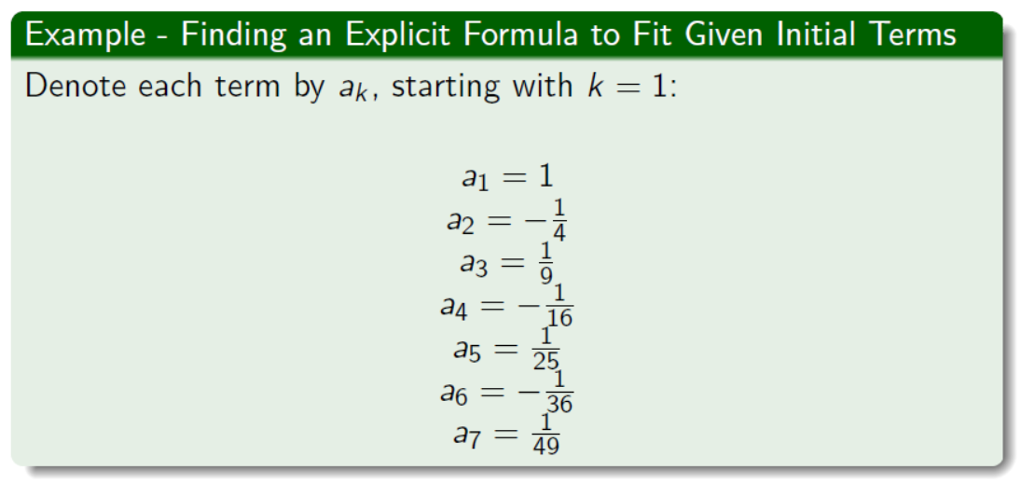

Slide 27
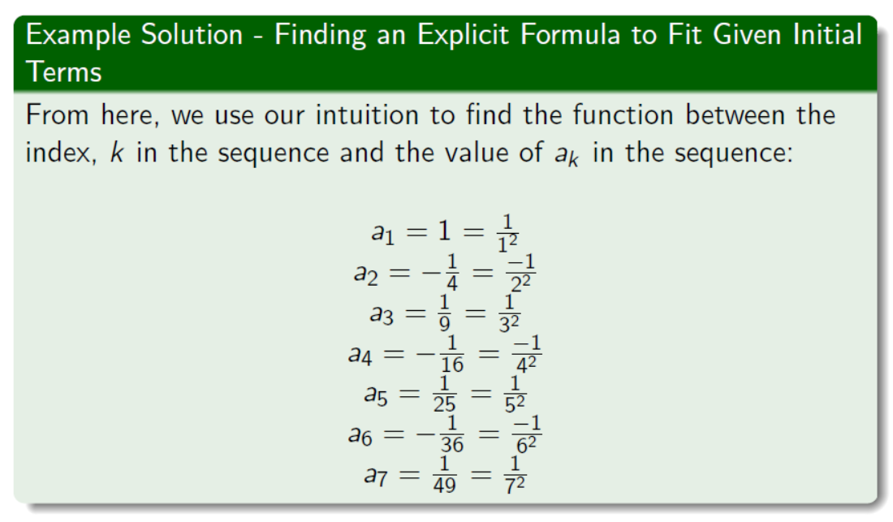

Slide 28
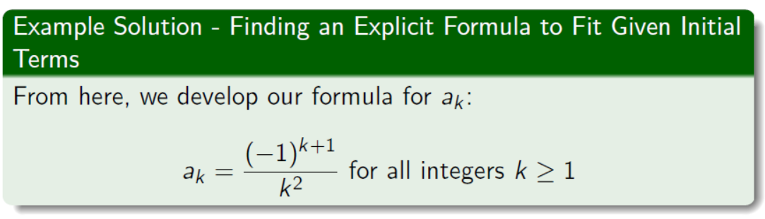

Slide 29
Figure Sources
Professor Joe Johnson’s Lecture Slides

